Slide 1
Marco Polo Travels

Slide 2
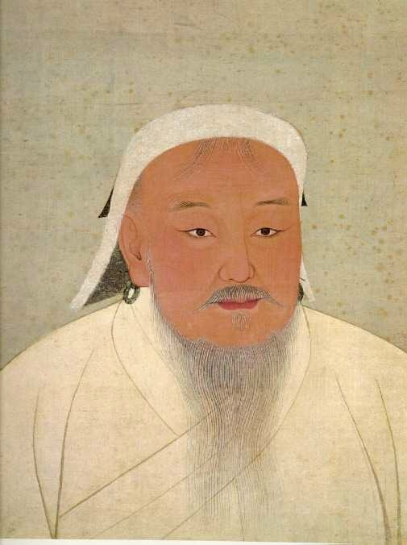
Genghis Khan
(Chinggis Kaan)
(r. 1206 - 1227)
National Palace Museum, Taipei
14th c.

Slide 3
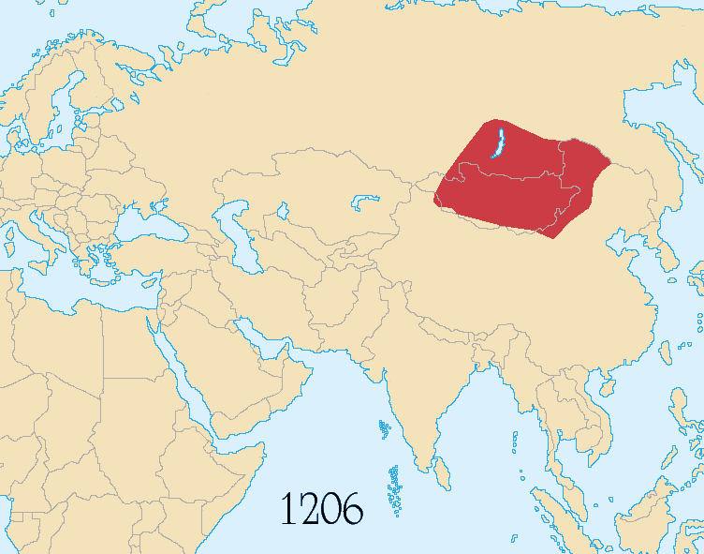
Mongol Empire
Territory from 1206-1294

Slide 4
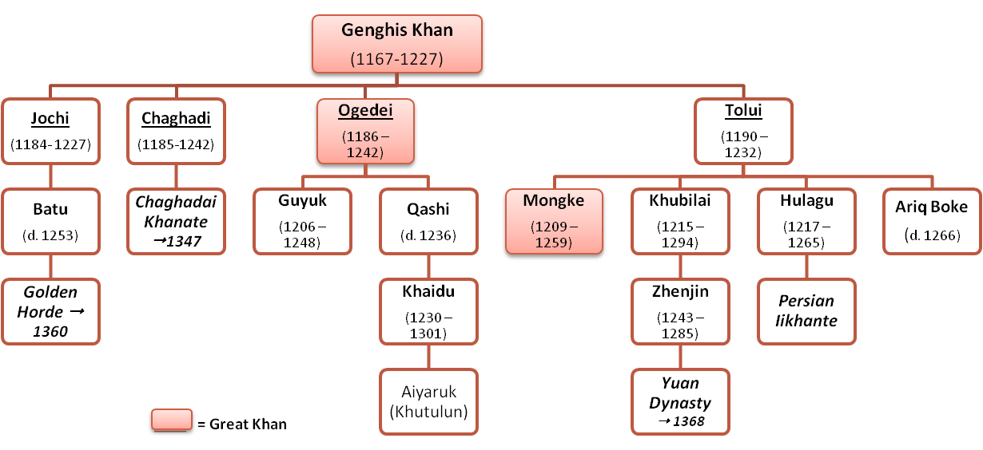
Genghis Khan
Family Tree

Slide 5
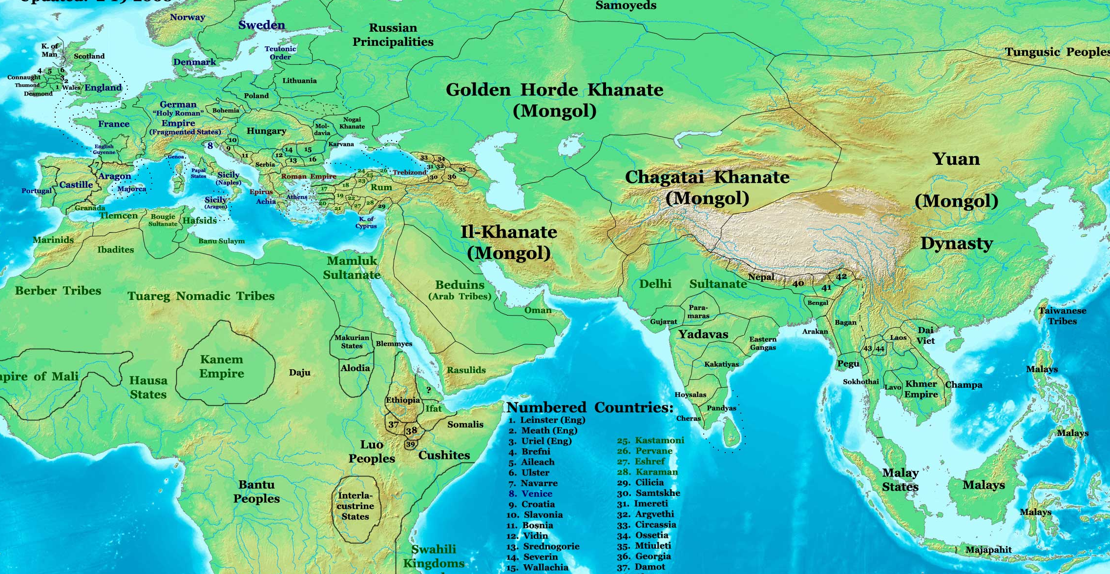
Political Divisions (c. 1300)

Slide 6
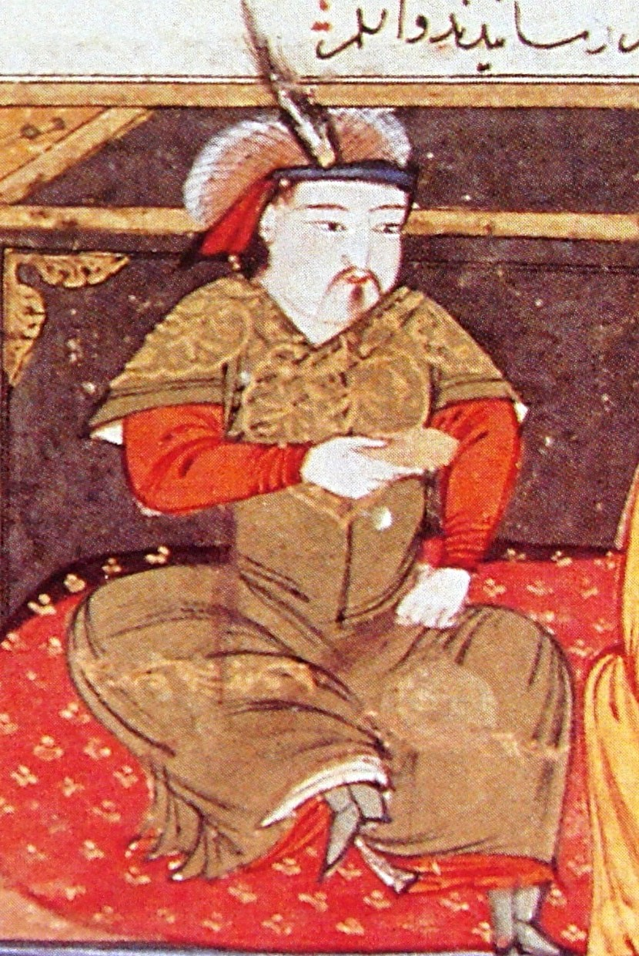
Hulagu Khan
(c. 1218 - 1265)
Rashid-al-Din Hamadani
Early 14th c.

Slide 7
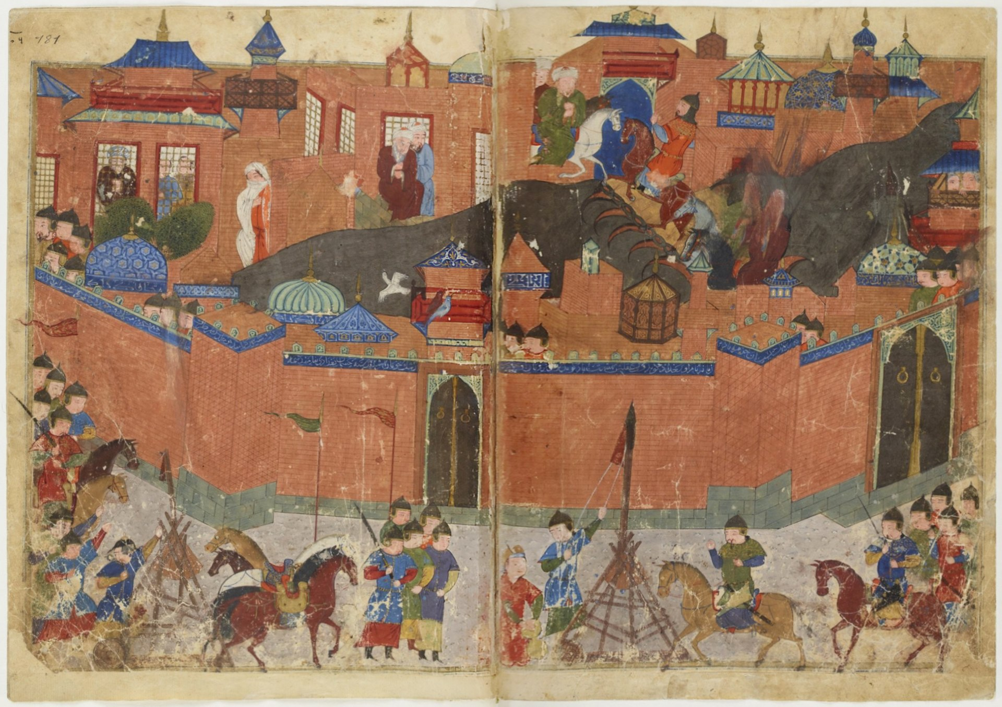
Siege of Baghdad (1258)

Slide 8
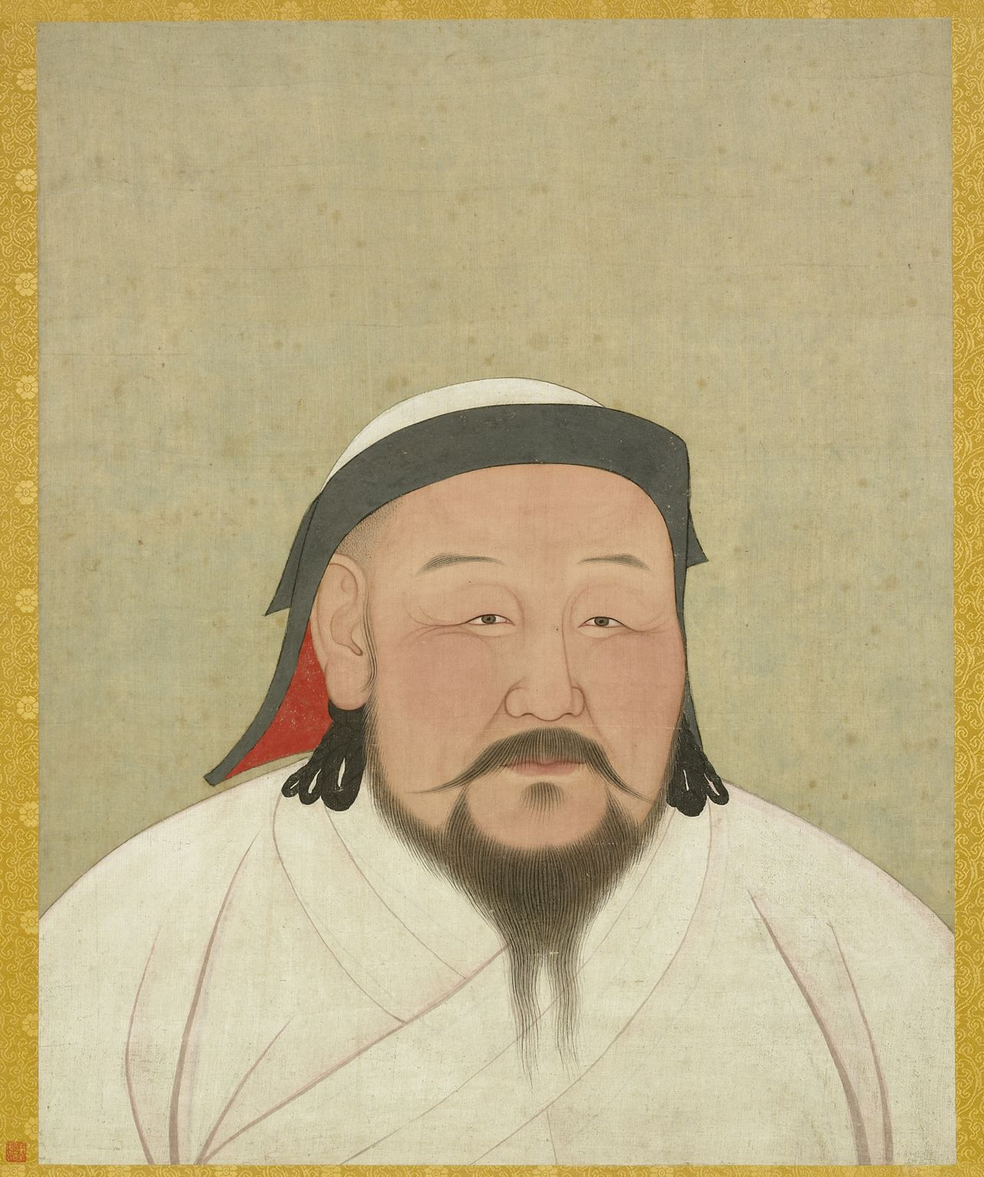
Kublai Khan
(Qubilai/Khubilai)
(r. 1260 - 1294)
Aniko/Araniko (c. 1300)
National Palace Museum, Taipei

Slide 9
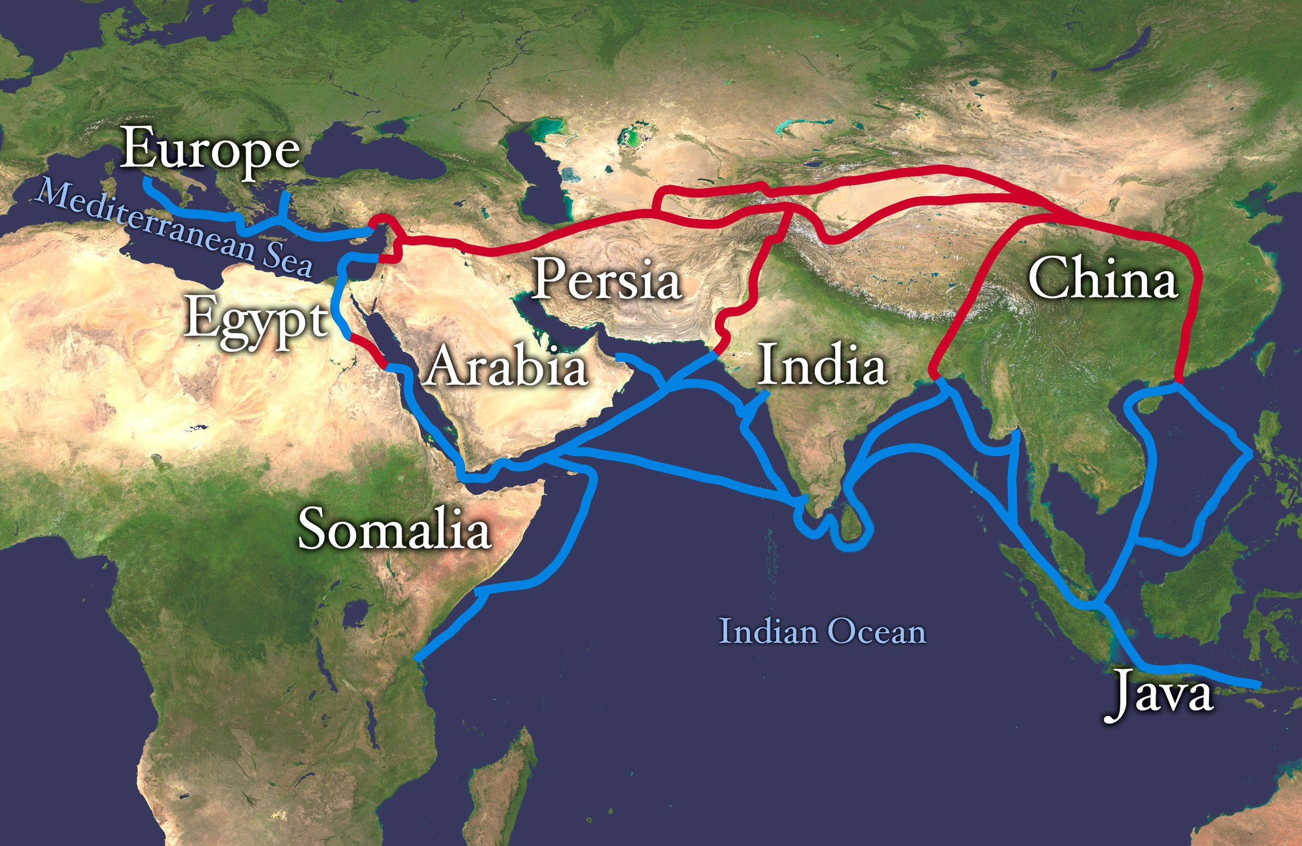
Silk Road
(~2nd c. BCE – 1450s)

Slide 10
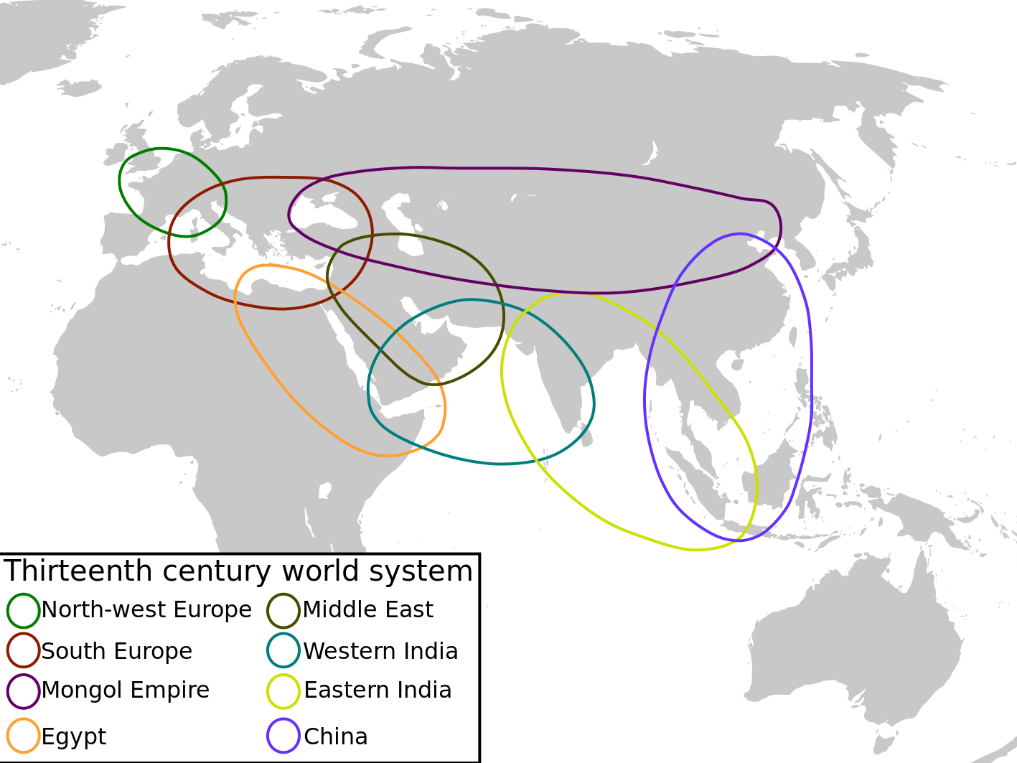
13th Century World Systems

Slide 11
Silk Road
(~2nd c. BCE – 1450s)

Slide 12
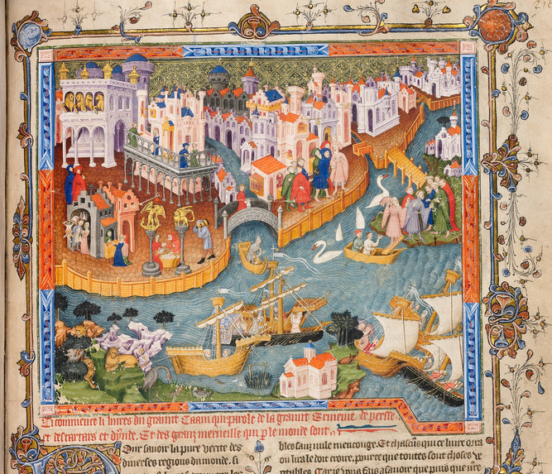
Medieval Venice
Marco Polo Leaving Venice
Oxford, Bodleian Library
Ms. Bod. 264, fol. 218r

Slide 13
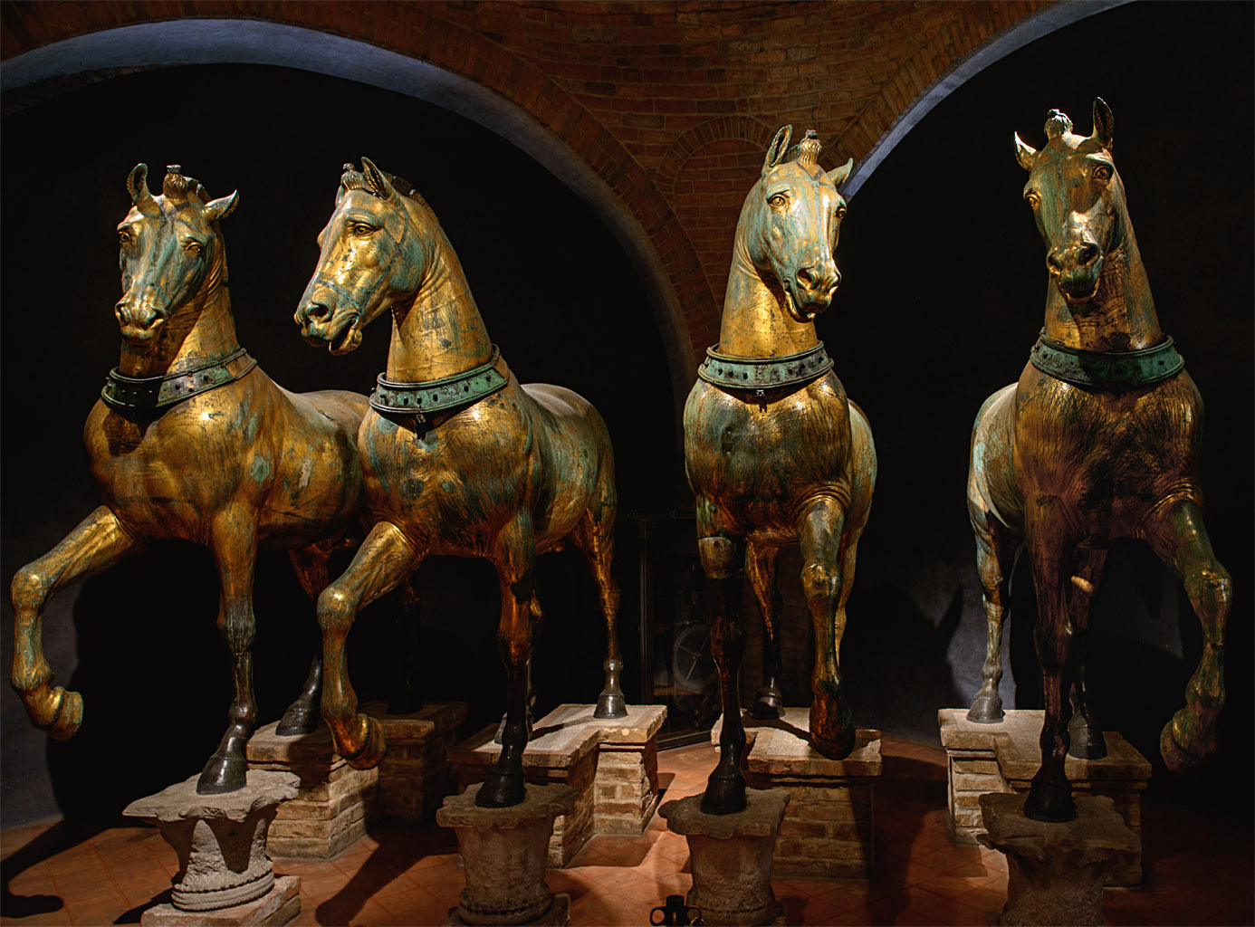
Horses of Saint Mark
(c. 2nd-3rd C)

Slide 14
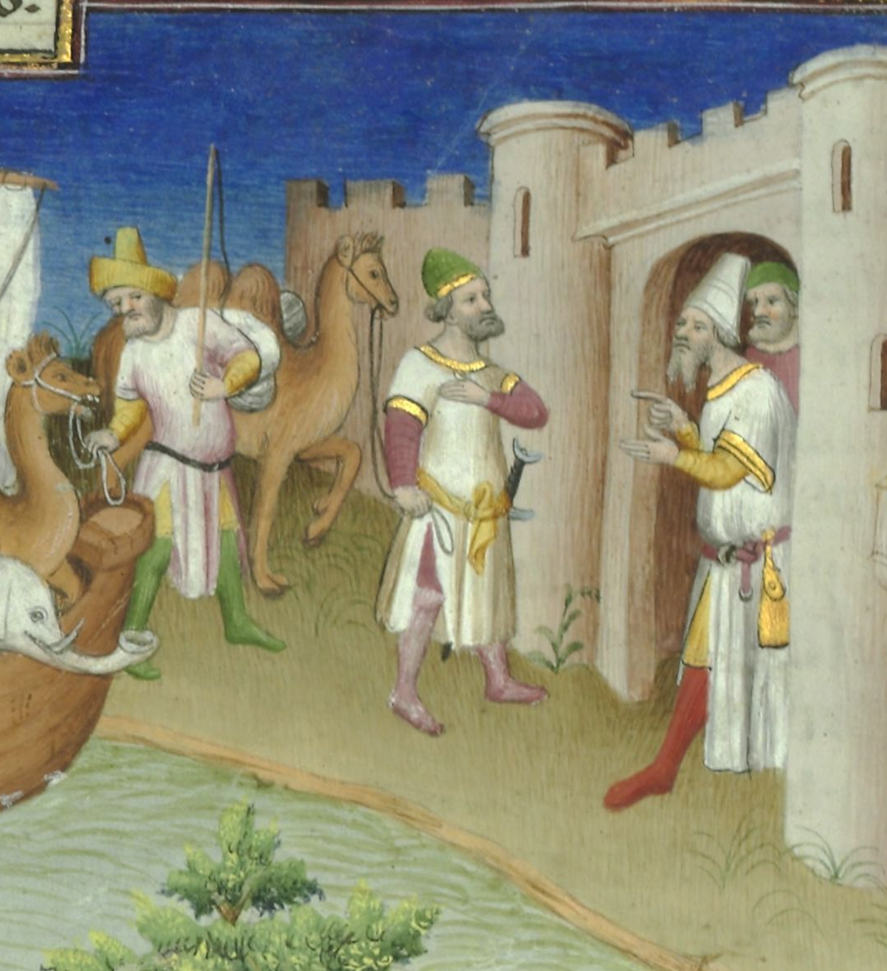
Marco Polo
(1254 – 8 Jan 1328)
Bibliothèque nationale de France
Ms. fr. 2810, fol. 14v

Slide 15
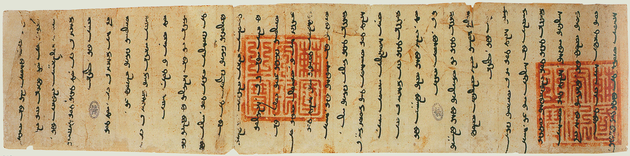
Letter from Arghun Khan to
Pope Nicholas IV, adopting Christianity throughout the Ilkhanate (1290)
Letter in Mongolian language and script, seals (red) in Chinese
Rome, Vatican Archives

Slide 16
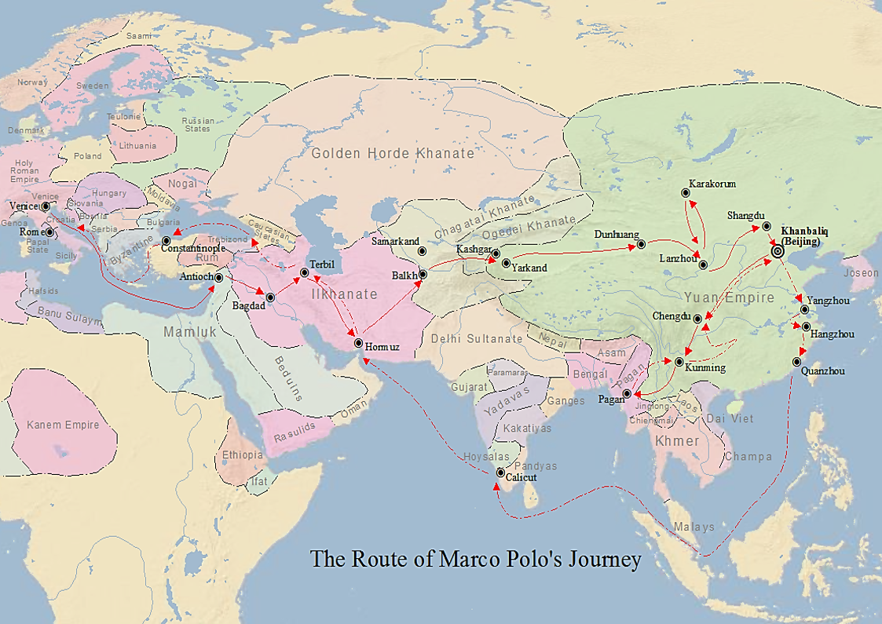
Marco Polo’s Travel Route

Slide 17
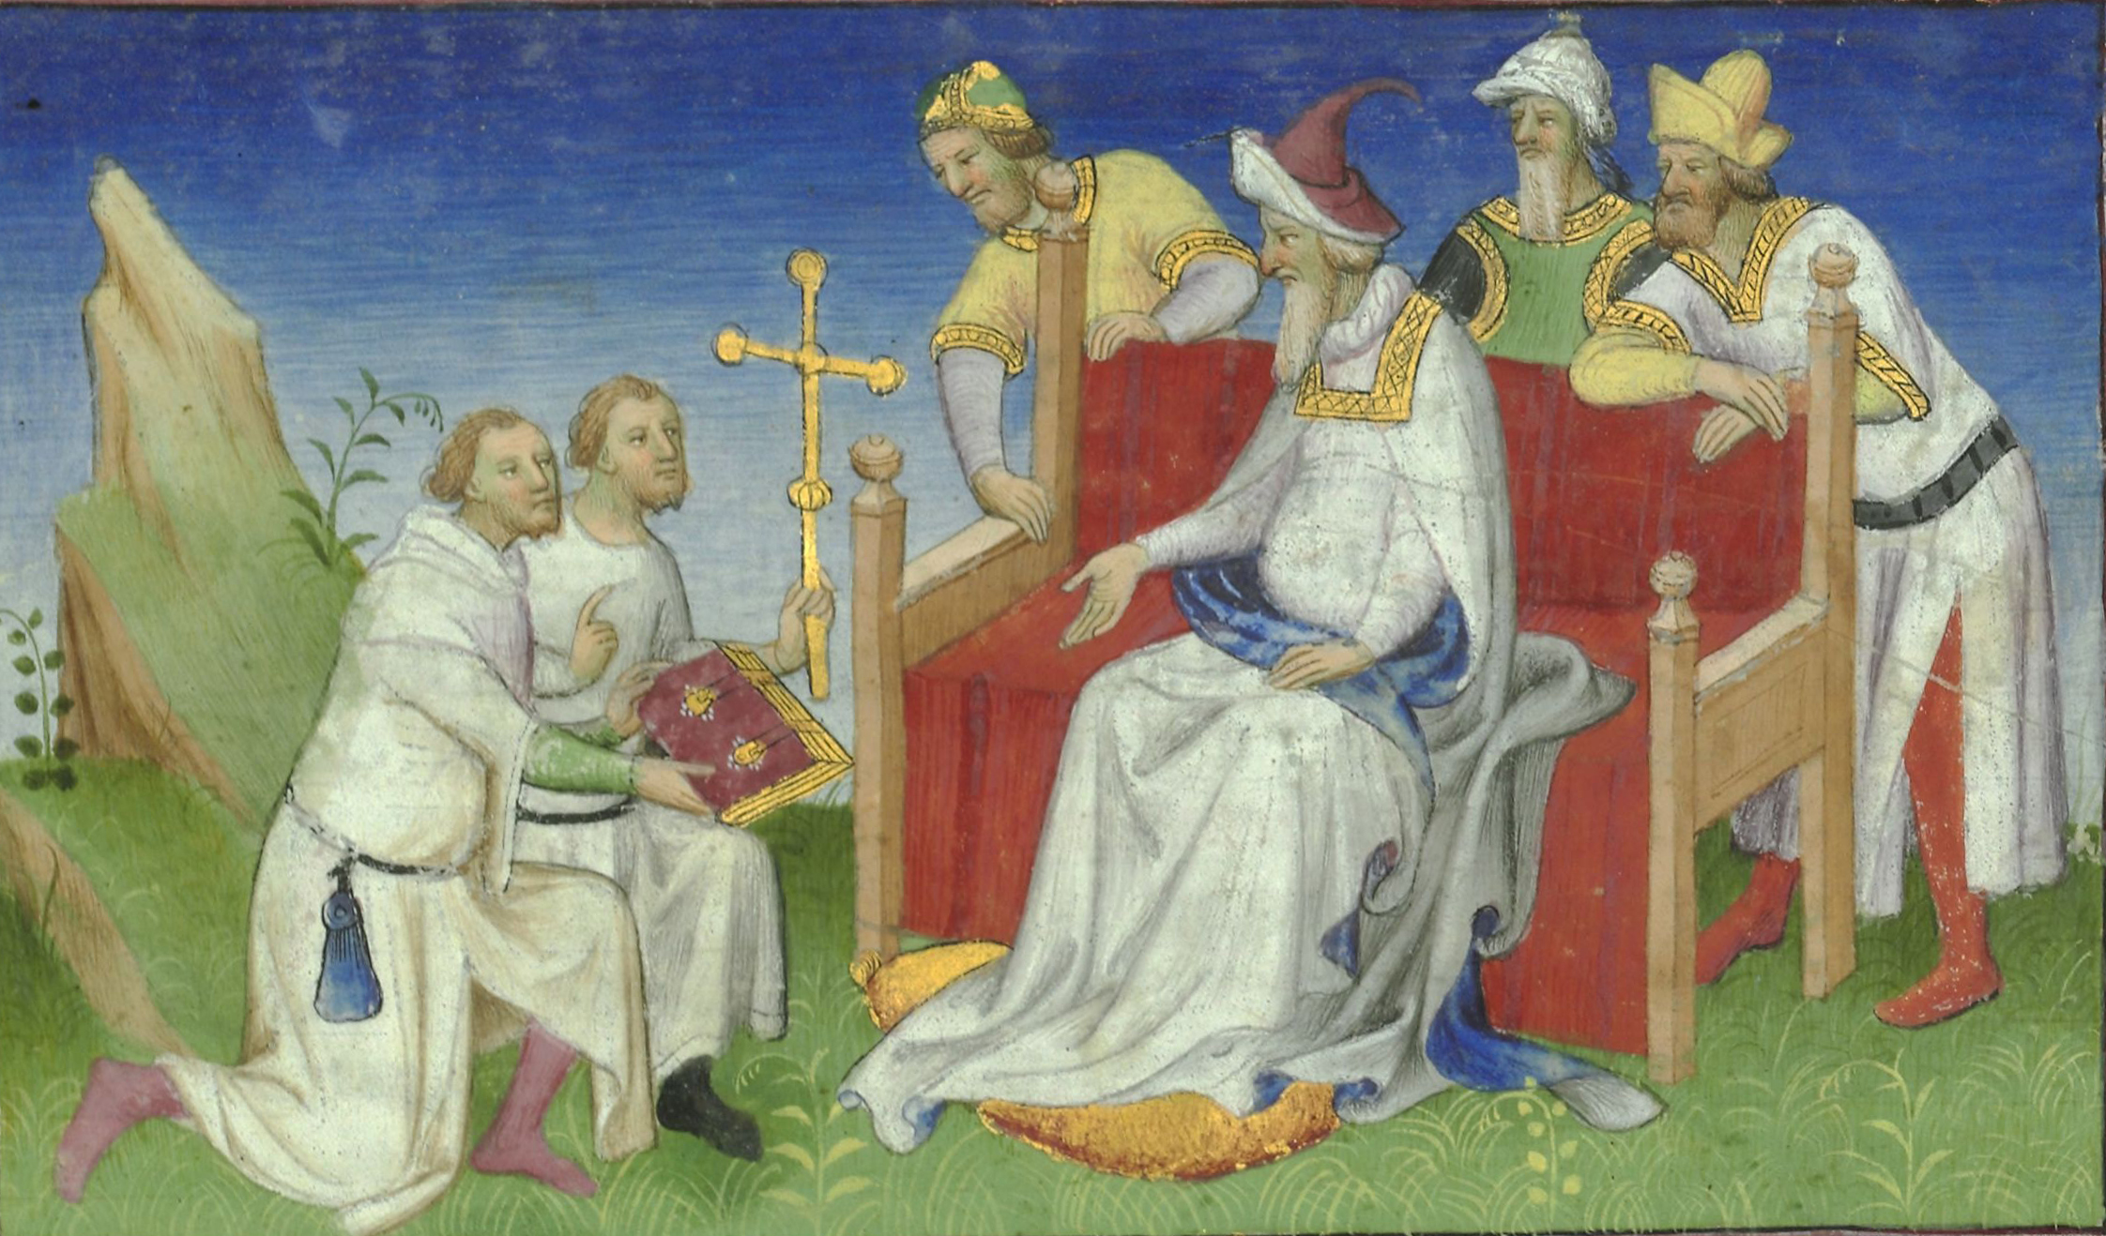
The Polos return to Kublai Khan
Bibliothèque nationale de France

Slide 18
Marco Polo’s Travel Route

Slide 19
Marco Polo Travels (or) Book of the Marvels of the World (or) Description of the World (or) Il Milione

Slide 20


Debating Marco Polo
(1995)
(1999)

